Slide 1
Build and Modernize AI Apps
L200 deck

Slide 2
Generative AI adoption is growing rapidly
66%
79%
3.5x
Respondents likely to redesign business processes with AI¹
Leaders agree their company must adopt AI to stay competitive²
For every $1 a company invests in AI, it is realizing an average return of³
1. 2024 Work Trend Index Annual Report, Microsoft and LinkedIn
2. 2024 Work Trend Index Annual Report, Microsoft and LinkedIn
3. The Business Opportunity of AI, IDC, November 2023

Slide 3
In the age of AI, every app should be intelligent
Apps
Data
GenAI models

Slide 4
Generative AI makes apps truly intelligent
Intelligent apps
Natural language interaction
Data-driven, personalized experiences that improve over time
Quickly deliver new features
Modern apps
Modern app development principles
Microservices-based architecture
Rapid innovation with CI/CD

Slide 5
This transformation to intelligent apps is accelerating
1Bn
80%
89%
New logical apps forecasted to be created by 2028¹
“By 2026, more than 80% of enterprises will have used generative AI APIs, models and/or deployed GenAI-enabled applications in production environments, up from less than 5% in 2023”²
Enterprises accelerating or maintaining application modernization investments over the next year³
https://www.idc.com/getdoc.jsp?containerId=US51953724
Gartner™: Top Strategic Technology Trends for 2024, 16 October 2023. GARTNER is a registered trademark and service mark of Gartner, Inc. and/or its affiliates in the U.S. and internationally and is used herein with permission. All rights reserved.
Unlock Competitive Advantage With Application Modernization - A commissioned study conducted by Forrester Consulting on behalf of Microsoft, 2024..

Slide 6





Challenges to fully realizing the benefits of Intelligent apps
Shortage of skilled developers
Legacy app and data architectures
Long release cycles
Growing security threats
Aligning use cases to business outcomes

Slide 7
Develop intelligent apps faster on Azure
50%
1.5
150%
Less time in developing new applications¹
Months faster to market for new apps²
Increase in work output due to Azure AI³
The Business Value of Migrating and Modernizing to Microsoft Azure – IDC
The Total Economic Impact™ Of Microsoft Azure App Innovation - A commissioned study by Forrester Consulting, 2024. Results are for a composite organization.
The Total Economic Impact™ Of Microsoft Azure AI - A commissioned study by Forrester Consulting, 2024. Results are for a composite organization.

Slide 8
Azure AI application platform
Build New or Modernize
Platform engineering and AI-assisted operations
API and Integration services
Partner Tools and Services
Developer services
AI platform
Container services
Platform-as-a-Service
Serverless
Data platform
Security, Governance and Responsible AI
AI-assisted development
Any App, architecture and language

Slide 9


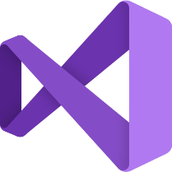



Most loved developer tools and services
Microsoft developer solution
AI assistance with GitHub Copilot
Dev Compute
DevOps
App templates and Azure tools
Dev Box (w/ Visual Studio)
GitHub
Azure
Security
Complete developer toolchain
Modern DevOps and platform engineering
Enterprise security and governance

Slide 10









Azure application platform
Comprehensive set of services to build and modernize intelligent apps
Container services
Platform as a Service
API services
Integration and Serverless services
Enterprise-grade managed Kubernetes and containers
Fully managed Platform as a service for web applications
Enterprise-wide API discovery, security and governance
Integration services for business process workflows and serverless functions
Azure Kubernetes Service
Azure Container Services
Azure Red Hat OpenShift
Azure App Service
Azure API Management
Azure API Center
Azure Functions
Azure Logic Apps
Azure Service Bus
Global scale
Enterprise grade
Open ecosystem
Developer-centric

Slide 11












Microsoft Intelligent Data Platform
Power AI innovation, no matter where your data resides
Databases
• Analytics • AI • Governance
Azure SQL Database
Azure Cosmos DB
Azure Database for
PostgreSQL
Azure Database for
MySQL
Microsoft Fabric
Azure Databricks
Azure AI
Microsoft Purview
Get the most from your data
Achieve your ambitions
Build confidently
Build your way

Slide 12
Azure AI
Everything you need to build unique GenAI experiences that scale
Innovate
with your best models
Select from a curated collection of cutting-edge models in the Model Catalog, where you can benchmark and evaluate with a unified API
Differentiate
with your own data
Seamlessly ground your apps in all types of data from any source and deliver high-performance with Azure AI Search for state-of-the-art retrieval
Safeguard
with responsible AI tools
Get in front of new threats like indirect prompt injections and jailbreaks with Azure AI Content Safety, protecting
your apps from both input and output
Full-Lifecycle Management
Streamline the development process as models evolve with Azure AI Studio, providing a single hub for model discovery, customization, monitoring and ongoing iteration

Slide 13










With Azure, the latest open-source and foundation models are under one roof
Microsoft Family
Cost-effective, domain-specific SLM efficiency
Meta Family
Use case versatility, open-source ethos and safety
Nvidia Family
High-quality, reliability and designed for optimization
Azure OpenAI Family
Multimodal GenAI, privacy, security and enterprise scale
Cohere Family
Performance, low-latency
and built-in grounding
Databricks Family
Expertise in enterprise workloads and databases
Mistral Family
Exceptional language and multilingual reasoning
Hugging Face Family
Open-source options that are accessible and adaptable
Snowflake Family
Cost-effective training, helpful coding and resources
Image generated with AI using Microsoft Designer

Slide 14

Comprehensive capabilities to deliver intelligent apps
Intelligent app use cases based on customer engagements
End to end security across the application lifecycle
Earlier access to AI innovation and broadest selection of AI models
Extensibility and open ecosystem with partners
Unmatched performance and resilience for databases
Any developer, any app, any architecture and language

Slide 15
Delivering on intelligent apps transformation requires
Identify intelligent app use cases aligned to business outcomes
Modernization of existing application and data estate for AI
Platform operations for intelligent app deployment

Slide 16
Intelligent apps use cases

Slide 17




Reinvent customer experiences with intelligent apps
Use cases
Personalization & product discovery
Content generation & marketing
Service & support
Build your own copilot
Deliver personalized shopping experiences for customers by analyzing data on their behaviors and preferences and leveraging semantic search capabilities
Create personalized marketing content across platforms, from social media posts to product descriptions
Provide personalized and interactive responses to answer customer questions and facilitate routine tasks
Go beyond bots to chat with your data using natural language, generate and summarize content, surface information over vast amounts of data, and provide engaging experiences
Engage customers and present fashion recommendations based on trend data
CarMax uses AI to produce content for car research web pages
30% cost reduction for customer support interaction³
TomTom’s Digital Cockpit understands 95% of complex requests, improving response time from 12 seconds to 2.5 seconds⁴

Slide 18
Personalization and product discovery
Use cases
Use Case Description
Leverage AI models to present personalized content, products, or services to users based on multimodal user inputs from text, images, and speech, grounded on a deep understanding of customer profiles
Product discovery is improved by searching for products semantically.
Personalized search and discovery drives user engagement, customer satisfaction and retention
REINVENT CUSTOMER EXPERIENCES
Use Case Examples
Consumer packaged goods, travel, retail e-commerce sites
Conversational shopping interface
Image search for products
Product or service content recommendations
Key considerations
Integrate multiple data types (e.g., user profiles, real-time inventory data, store sales data, social data)
Pre-trained AI models that can handle multi-modal inputs and can learn from user data to deliver personalized results
Scale to meet variable user demand

Slide 19


Customer story
“Having a conversational interface option gets us closer to our goals of fully engaging the customer and personalizing their experience by showing them the most relevant products at the most relevant time.”
Cliff Cohen, Chief Technology Officer, Asos

Slide 20









Personalization and product recommendations
Use cases
Deliver real-time recommendations and dynamic customer experiences
Raw Data
Intelligent Application
Product Catalogue
Azure Storage
Static content, PDFs, images, etc.
Azure AI Search
Vector Search
Customer chat history
Marketing and Campaign Data, Promos etc.
Azure Cosmos DB
Azure OpenAI Service
Conversational eCommerce Experience
Customers
Retraining of ML models
Change Feed
Customer Data
Purchase history, product reviews, customer profiles
Azure Functions
Azure ML
Azure Kubernetes Service

Slide 21
Content generation and marketing
Use cases
Use Case Description
Generates text or image content using generative AI.
Automates the creation of web or mobile content, such as product descriptions for an online catalog or visual campaign assets based on marketing narratives, accelerating time to market.
Enable faster iteration and A/B testing to identify the best descriptions that resonate with customers.
REINVENT CUSTOMER EXPERIENCES
Use Case Examples
Marketing campaign ideation and content drafting, automated translation​
Campaign or website message testing
Automated summary of user reviews
Marketplace product descriptions and image generation
Key considerations
Integrate multiple data types (e.g. product information, reviews, user profiles etc..)
Generative AI models that can generate text and images based on user profile and behavior
Integration with marketing campaign or website content workflows

Slide 22


Customer story
Our initial goal was customer review summaries for 5,000 car pages, and we figured that using our existing manual process it would have taken about 11 years of content generation. With OpenAI Service, we hit that goal in just a few months…”
Sean Goetz, Director, Application Systems at CarMax

Slide 23





Sample architecture: Product description generator
Use cases
Azure
Function App
Customer sees product description on website
Orchestration
Summarize/ Generate Content
Save Description to file
Create Prompt
Azure Database for PostgreSQL
Azure Database for PostgreSQL
API
Management
Product manuals, descriptions and meta-information
Description is saved to DB
Azure
OpenAI
Customer
This pattern generates text or image content based on conversational user input. It combines the capabilities of Image Generation and Text Generation. The content generated may be personalized to the user.
Data may be read from a variety of data sources, including Storage Account, Azure Cosmos DB, Azure Database for PostgreSQL, or Azure SQL
Content Generation

Slide 24
Service & Support
Use cases
Use Case Description
REINVENT CUSTOMER EXPERIENCES
Offer self-service natural language chat interface for customers to resolve service issues faster
Intelligently route and divert calls, allowing agents to focus on the most complex cases
Enable customer service agents to quickly access contextual summary of prior interactions and offer real-time recommendations
Enhance customer service agent productivity by automating repetitive tasks with AI such as logging interaction summaries
Use Case Examples
Self-service chatbots for customer support
Real-time recommendations to agents for customer interactions
Post call analysis and coaching for service agents
Automated summary of customer interactions
Key considerations
Natural language processing to understand and interpret user queries
AI models that can generate contextual summary based on customer interaction data such as transcriptions, chat queries and responses
Dynamic scalability to handle increased data processing demands
Continuous innovation and delivery to support updates to self service chatbots based on user and service agent feedback

Slide 25


Customer story
“Our associates say that as they read through the summaries, they often find information from the call that they had forgotten.”
Wendy Dempsey, Executive Director of Customer Experience, Ally

Slide 26





Airline customer service and support architecture
Use cases
Raw Data
Azure Cache for Redis
Flights
Azure API Management
Azure Kubernetes Service
Customer-facing apps
Azure Front Door
Customers
Customer Accounts and Metadata
Azure Database for PostgreSQL
Azure OpenAI Service
Policies
Azure AI Search
Customer Support System
Airline Employees

Slide 27
Build your own copilot for customer experiences
Use cases
Use Case Description
Provide enhanced services to customers through new or improved products - using AI to provide data-driven insights that facilitate personalized customer interactions
Enable customer access to a wider range of information, while leveraging AI capabilities to improve search queries and make data more accessible
REINVENT CUSTOMER EXPERIENCES
Use Case Examples
AI-powered product experiences
Customer research
Account maintenance
Key Considerations
Natural language processing to understand and interpret user queries
Continuous innovation/delivery to continually enhance customer experience
Dynamic scalability to handle increased data processing demands

Slide 28
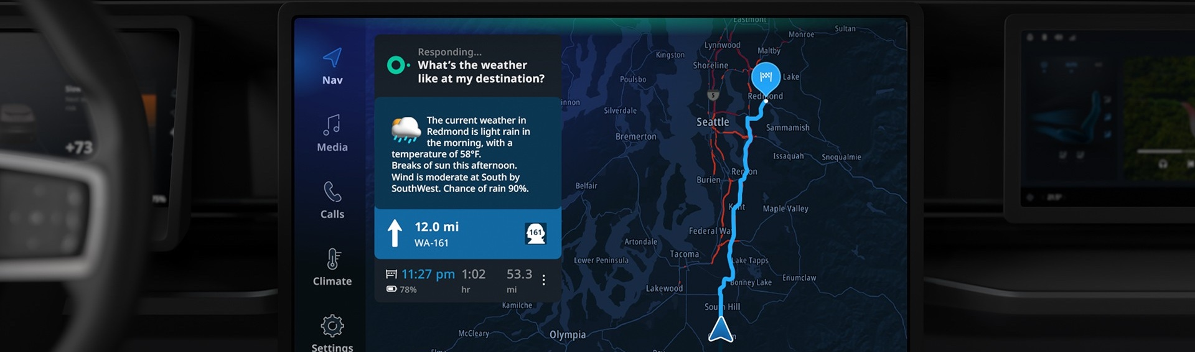

Customer story
“We use Azure OpenAI Service, Azure Cosmos DB, and Azure Kubernetes Service because we’ve identified these as key services that facilitate the acceleration of AI apps.”
Ivan Diaz, Principal Staff Engineer for AI Services, TomTom

Slide 29

Build your own copilot architecture
Use cases
2
Legend:
0
Populate metadata
7
Return answer
Semantic Kernel orchestrated call
Submit question & history
Blob Storage
Other service calls
2
Vector & search pod
3
Request question embedding (embeddings API)
Request embeddings (embeddings API)
User interaction
#
Backend data flow
Source metadata
Frontend workflow
+
System prompt template
#
Index documents & embedding vectors
Azure OpenAI Service
Embeddings API
Change feed: source documents
1
3
4
Search for context data
Azure Cosmos DB
4
Persist embedding vectors
Azure AI Search
Hybrid index
5
Request completion (Completions API)
1
Source Data
6
Persist Q&A
Ask question
+
Prompts & completions
Azure OpenAI Service
Completions API
Q&A Web app
Chat users
GitHub repo

Slide 30




Reshape business processes with Intelligent apps
Use cases
Build your own copilot
Transaction processing and anomaly detection
Information discovery and knowledge mining
Document intelligence and summarization
Streamline employee access to information about internal policies, and internal documents
Handle high volumes of transactions swiftly, accurately, and reliably
Transform unstructured data, such as orders, contracts, applications, and forms, into structured digital information
Automate extraction, aggregation, and summarization of data from various sources, such as webpages, contact center logs and internal documents
70 percent of KPMG’s employees have adopted KymChat, making over 120,000 requests since its release¹
Manulife data scientists now take only days to set up an environment, making it much easier to detect fraud²
H&R Block tax professionals to find detailed client history in seconds and helps them sort through stacks of forms in seconds³
Using conversation intelligence to surface keywords and other relevant conversation data to help spot trends and quickly get a pulse on their customers.⁴

Slide 31
Build your own copilot for business processes
Use cases
Use Case Description
Organizes unstructured data to streamline document management and information
Leverages natural language processing to create a conversational search experience for employees
Provides more contextual and useful information to employees to help them become more productive
Summarizes data for analysis and improvement
REINVENT CUSTOMER EXPERIENCES
Use Case Examples
Employee chatbot for HR / benefits​
Professional Services assistance (Legal/Tax/Audit)​
Analytics and reporting​
Contact center agent assistance​
Employee self-service and knowledge management (IT + HR)
Key Considerations
Natural language processing to understand and interpret user queries
Prompt engineering training improve employee queries
Capability of integrating copilot with other internal workloads
Continuous innovation/delivery to support new internal resources and optimize chatbot dialog

Slide 32


Customer story
“In the past, (this employee) might have had to liaise with HR or conduct a time-consuming web search of multiple sources…Now they simply ask KymChat to create a list of 10 role-specific interview questions, and they have their interview prep finished in seconds.”
Robert Finlayson, Senior Product Manager, KPMG Australia

Slide 33
Build your own copilot architecture
Use cases
2
Legend:
0
Populate metadata
7
Return answer
Semantic Kernel orchestrated call
Submit question & history
Blob Storage
Other service calls
2
Vector & search pod
3
Request question embedding (embeddings API)
Request embeddings (embeddings API)
User interaction
#
Backend data flow
Source metadata
Frontend workflow
+
System prompt template
#
Index documents & embedding vectors
Azure OpenAI Service
Embeddings API
Change feed: source documents
1
3
4
Search for context data
Azure Cosmos DB
4
Persist embedding vectors
Azure AI Search
Hybrid index
5
Request completion (Completions API)
1
Source Data
6
Persist Q&A
Ask question
+
Prompts & completions
Azure OpenAI Service
Completions API
Q&A Web app
Chat users
GitHub repo

Slide 34
Transaction processing
REINVENT CUSTOMER EXPERIENCES
Use Case Description
Use Case Examples
Automate data extraction, categorization, and validation of data from documents
Transform unstructured data, such as claims, contracts, applications, invoices, and forms into structured digital information to facilitate downstream processes like insurance claim processing
Leverage computer vision to visually inspect machinery and products for defects, preventative maintenance, and safety concerns
Benefits: Process improvement, leading to greater productivity
Order processing
Buy online, pick up in store
Banking payments
Airline reservations
Employee payroll records
Patient appointment scheduling
Quality assurance
Equipment maintenance
Key considerations
Manage industry-specific compliance standards and regulations governing transactional data
Distributed database systems, designed for horizontal scaling, are increasingly used to handle large volumes of transactions.
AI and machine learning can automate routine tasks, and improve overall efficiency in transaction processing

Slide 35


Customer story
“With Azure, our customers can submit more documentation online, and we can then use document analysis to extract information and conduct processing to accelerate workflows, ensure accuracy, and improve user experiences.”
Len van Greuning, Chief Information Officer, John Hancock (Manulife)

Slide 36




Sample architecture: Real-time payments and transactions
Data sources
Data sources
Consumers
Databases
Azure OpenAI Service
Completions API
Consumers
Apps
Azure SQL DB
Account data
Azure Kubernetes Service (AKS)
Payments API / Worker Service
Azure Front Door
Static Web App
Account Managements
Agents
Files
Azure SQL DB
Account data
Azure SQL DB
Account data

Slide 37
Anomaly and fraud detection
Use cases
Use Case Description
REINVENT CUSTOMER EXPERIENCES
Use AI to identify patterns, anomalies, or suspicious activities that may indicate fraudulent transactions in real time
Real-time monitoring of transactions and activities allows for immediate detection and response to fraudulent behavior.
Analyzing user behavior and transaction patterns helps identify deviations from normal behavior, signaling potential fraud
Minimize financial impact by quickly identifying fraudulent activity and taking immediate actions
Use Case Examples
Suspicious financial transactions
False account chargebacks
Fraudulent insurance claims
Identify theft
Unauthorized account access or account takeover
Network intrusions or malware attacks
Fake product or content reviews
Key Considerations
Handle vast amounts of data and spot anomalies in real-time
Leverage predictive models in ML and AI algorithms to identify patterns and anomalies associated with fraudulent behavior
Continuously update applications to track fraud patterns as they evolve

Slide 38


Customer story
“Our first ambition at Swift is to build a foundation model for anomaly detection that underpins the detection and prevention of fraud. Our ultimate goal is collaborating with Microsoft and our community to start thinking about how we can stop fraud occurring in payments.”
Johan Bryssinck, AI/ML Product and Program Management Lead, Swift

Slide 39






Sample architecture: Interactive fraud analysis tool
Use cases
Real-time Transaction Processing
Intelligent Application
Payment Transactions
Azure SQL DB
Azure AI Search
(Full-text index)
Analytical Platform
Stock Trading Data
OneLake
Azure SQL DB
Fraud alerts
Payment metadata
Client profiles
Chat History
Azure OpenAI Service
Azure Cache for Redis
Custom Application
Interactive Fraud Analysis Tool
Analyst
Data Factory
Microsoft Fabric
Claims
Power BI
Real-time operative dashboard
Azure Kubernetes Service
Fraud Detection
This technical pattern enables the identification of fraudulent transactions, combining transaction and meta information with the context provided by LLMs.

Slide 40
Knowledge mining
Use cases
Use Case Description
REINVENT CUSTOMER EXPERIENCES
Analyze conversations for keywords to spot trends and better understand customers
Quickly find information to gain valuable insights and identify patterns
Utilize information in downstream processes to improve decision-making
Use Case Examples
Curated content summarization
Knowledge extraction and organization
Trend and sentiment analysis
Automated report and research generation
Key Considerations
Capabilities to extract relevant information and make it available for further analysis
Pre-trained machine learning for identifying patterns and making predictions

Slide 41


Customer story
“Machine learning frees up the precious time we have with the client to actually have richer conversations about their financial needs and aspirations, beyond the immediate task of ensuring the best tax outcome for the current year.”
Aditya Thadani, Vice President, H&R Block

Slide 42




Sample architecture: Enterprise search and knowledge mining
Use cases
Container Registry
App Service
Web Front-end to navigate the indexed data for a search UI experience
Call and Text Recordings
Azure SQL DB
Azure Functions
Azure SQL DB
Azure AI Search
As processed recordings and text-based conversations are uploaded they trigger the automatic Batch Transcription job
Each json/wav file exported represents one conversation (customer to agent, voice or text chat)
The resulting transcriptions are stored in a database, along with the enriched metadata (diarization, sentiment, etc.)
Azure Functions
Azure OpenAl Service
Key
Container Registry
This is hosted externally in a different Azure resource group and is not deployed as part of the solution to the user's Azure subscription/ resource group
A set of custom and pre-built functions that implement the different use cases
Azure Al Services
Conversational Knowledge Mining Solution Accelerator GitHub
Enterprise Search and Knowledge Mining
This technical pattern enables customers to conduct large scale knowledge mining to find information and gain valuable insights and patterns.

Slide 43
Document intelligence and summarization
Use cases
Use Case Description
REINVENT CUSTOMER EXPERIENCES
Helps classify, extract, summarize, and gain deeper insights from documents using natural language prompts
Automates basic tasks previously done manually to enable workers to focus on higher-value tasks
Expedites access to historical data to help employees problem-solve
Use Case Examples
Tax forms processing and analysis for insights​
Documentation of clinician-patient visit and entering summary into downstream systems​
Meeting summaries and notes
Key Considerations
Identification of tasks to be automated
Refine downstream workloads to leverage summarized data
Streamlined employee access to historical data

Slide 44


Customer story
“I think the real tangible benefit of conversation intelligence is how we can capture all this call data accurately and how we can use all of that automation to make sure we don’t miss anything.”
Lee O’Brien, Group Chief Artificial Intelligence Officer, Investec

Slide 45





Sample Architecture: Large document summarization
Use cases
Azure
User can see summaries of large documents in PowerApps application
API Management
Large Document
Function App
Orchestration
Storage Accounts
Summarize
data
Summarized Document
Extract
Azure Cosmos DB
Upload triggers workflow
Document chunks
Summarized chunks
Business user
Business user
AI Document Intelligence
Azure
OpenAI Service
Document summarization
This technical pattern enables customers to conduct knowledge mining to gather information and gain valuable insights and patterns in aggregate over large repositories of documents
Data may be read from a variety of data sources, including Storage Account, Azure Cosmos DB, Azure Database for PostgreSQL, or Azure SQL

Slide 46
Delivering on intelligent apps transformation requires
Intelligent App use cases aligned to business outcomes
Modernization of existing application and data estate for AI
Platform operations for intelligent app deployment

Slide 47

Modernizing app and data estate for AI
Modernize
61%
51%
46%
Modernizing to infuse GenAI Capabilities¹
Less time developing new features¹
Less time in developing new applications²
Unlock Competitive Advantage With Application Modernization - A commissioned study conducted by Forrester Consulting on behalf of Microsoft, 2024.
The Business Value of Migrating and Modernizing to Microsoft Azure – IDC

Slide 48
Why Modernize your app and data estate?
Modernize
Enable platform readiness for AI innovations
Improve agility, scalability and performance
Improve enterprise security and compliance
Optimize IT infrastructure for improved efficiency
Accelerate developer productivity and increase dev velocity

Slide 49
Modernizing app and data estate for AI is driven by clear business outcomes
Modernize
Application Modernization
Data Modernization
Process Modernization
Improving security posture
Decrease tech debt
Cost optimization
Improve agility, scalability and performance
Centralizing data for AI
Improve data quality and trust in data
Improve operational efficiency
Exiting datacenter
Reshaping developer experience
Improving development cycles
Automate workflow and processes
Secure development workflows

Slide 50
Modernize app and data estate for AI Leverage continuous modernization for optimization and drive business growth
Modernize
Assess App and Data estate
Rationalize app portfolio
Plan, execute, operationalize
Innovate and infuse AI
Ongoing modernization
Application and data estate
Align to present and future business needs
Build out a clear plan for modernization
Infuse new capabilities and make apps intelligent
Ongoing modernization based on business needs

Slide 51




Assessing your application estate for modernization
Modernize
Get app and data estate ready for innovation
Comprehensive offerings
Microsoft solutions
App Inventory
Unified view of app and data portfolio
Azure Migrate
App insights
Functionality, usability, security, performance
Azure Migrate Application and Code Assessment
Effort estimation
Identify optimal path for applications
Partner solutions
CAST Highlight
Technical requirement
Uncover technical bottlenecks and requirements
Unify Cloud
Dr Migrate

Slide 52
Modernization requires a portfolio approach aligned to outcomes
Modernize
Comprehensive offerings for modernization on Azure
Modernization
Comprehensive AI ready platform services
Migration
Enterprise-grade end-to-end security
Support for all language and frameworks
Retire
Rehost
Replace
Replatform
Rearchitect
Rebuild
Enterprise skilling and enablement
Discontinue use of existing application
Redeploy as-is to cloud virtual machines [lift-and-shift]
Convert application to SaaS or Low-code
Minimally alter to take advantage of cloud managed services
Materially alter or decompose application to services
Rewrite application with cloud native approach
Ecosystem of partners
Extensive coverage from assessment to deployment
More effort and greater innovation benefits

Slide 53



Replatform apps and data to managed PaaS
Modernize
Technical requirements
Application Architecture
Data Storage and Persistence
Security and Compliance
Integration with Other Services
Monitoring and Logging
Deployment and Scaling
Deploy and scale app and data seamlessly on the cloud, reduce cost, boost performance and time to value
Scenario Description
Migrate app and data to managed cloud platform service with minimal code changes for higher performance
Provides all the benefits of running apps and data on the cloud such as scalability, simplified DevOps, improved security, higher availability and reliability
Technology Stack
Application Services
Database
Key Considerations
Azure App Service
Azure Kubernetes Service
Azure Database for PostgreSQL
Azure SQL Database
Scaling apps to meet demand is difficult and cumbersome affecting app performance
Difficulty managing servers, databases, network is time consuming and need to focus on building and delivering innovation products
Security and compliance concerns

Slide 54


Customer story
“With our migration to PaaS, we got what we wanted: greater scalability, reliability, security, agility in managing our IT infrastructure—and greater peace of mind—all without the cost and hassle of doing this ourselves,”
Daniel Engberg, Head of AI, Data, and Platforms at SAS – Scandinavian Airlines

Slide 55



Rearchitect business critical apps to microservices
Modernize
Technical requirements
Decomposition Strategies
Frameworks and State Management
Database performance and scaling
Continuous Integration and Continuous Delivery
API driven development
Observability
Decouple apps, scale app performance, and boost innovation agility with microservices architecture
Scenario Description
Decouple monolithic applications into individual microservices with each service handling a specific functionality or business domain
Improve flexibility and reduce service dependencies by loosely coupling services via APIs or event
Requires developer resources and significant time to implement
Technology Stack
Application Services
Database
Key Considerations
Azure Kubernetes Service
Azure App Service
Azure Database for PostgreSQL
Azure SQL Database
Azure Cosmos DB
Application is difficult to manage and maintain as a monolith
Business requires more agility, flexibility, and scalability from application
Enable application teams work independently and collaboratively for faster innovation cycles

Slide 56


Customer story
“On the retail banking side, the bank has reduced customer onboarding duration from 3 days to 9 minutes thanks to the new digital platform.”
Ulaş Ergin, IT, Digital Banking, and Software Architecture Department Manager, Credit Europe Bank NV

Slide 57

Modernize .NET applications on Azure
Modernize
With comprehensive AI integration, advanced developer tools, and seamless cloud solutions for innovation
Optimize costs with intelligent services that prevent over-provisioning
Attractive discounts for non-production (Dev/ Test) users
Fully managed offerings natively designed to support Windows and SQL
Native integration with Visual Studio
Protect your applications with built-in Firewall and Application Gateway

Slide 58




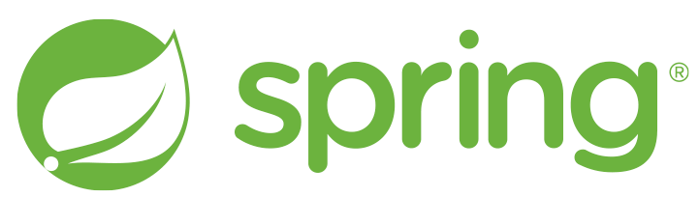



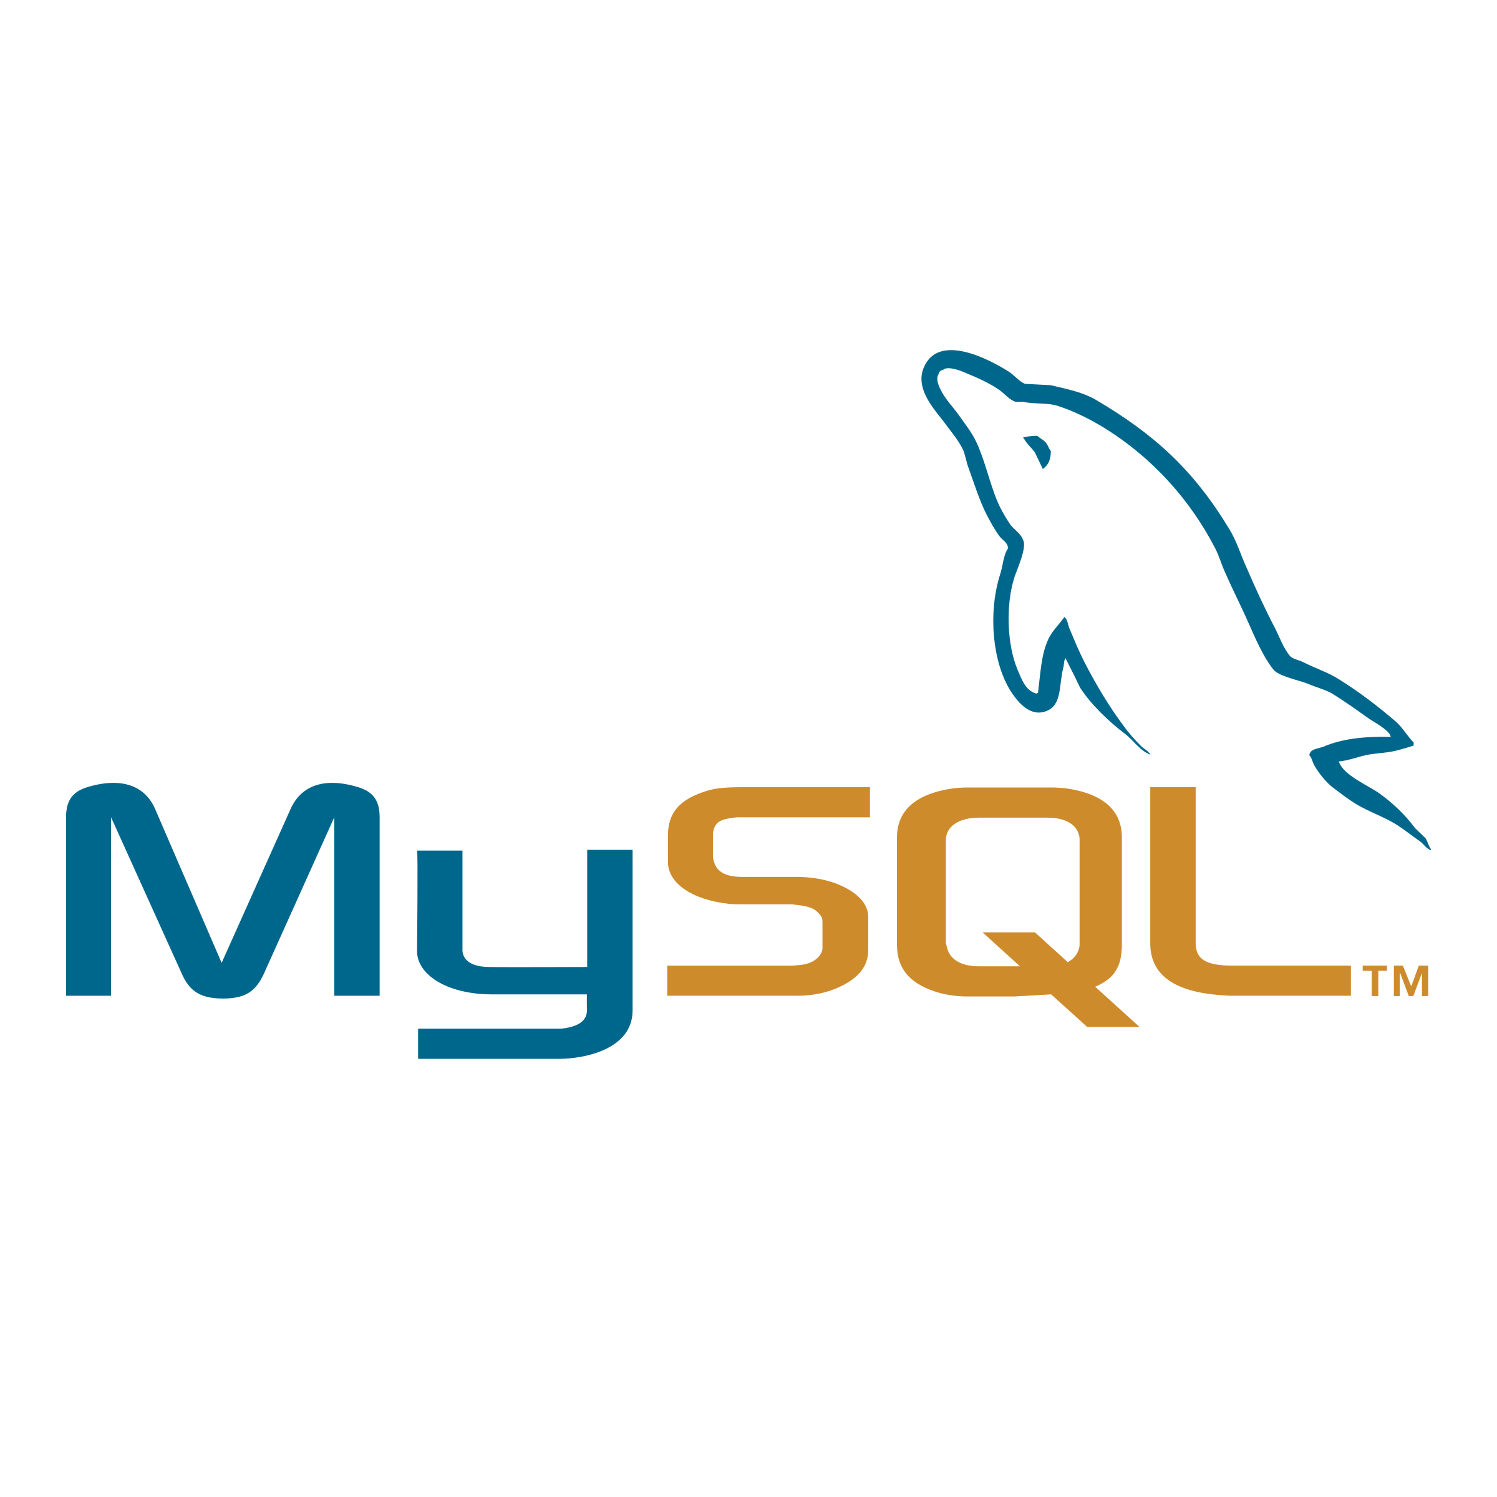
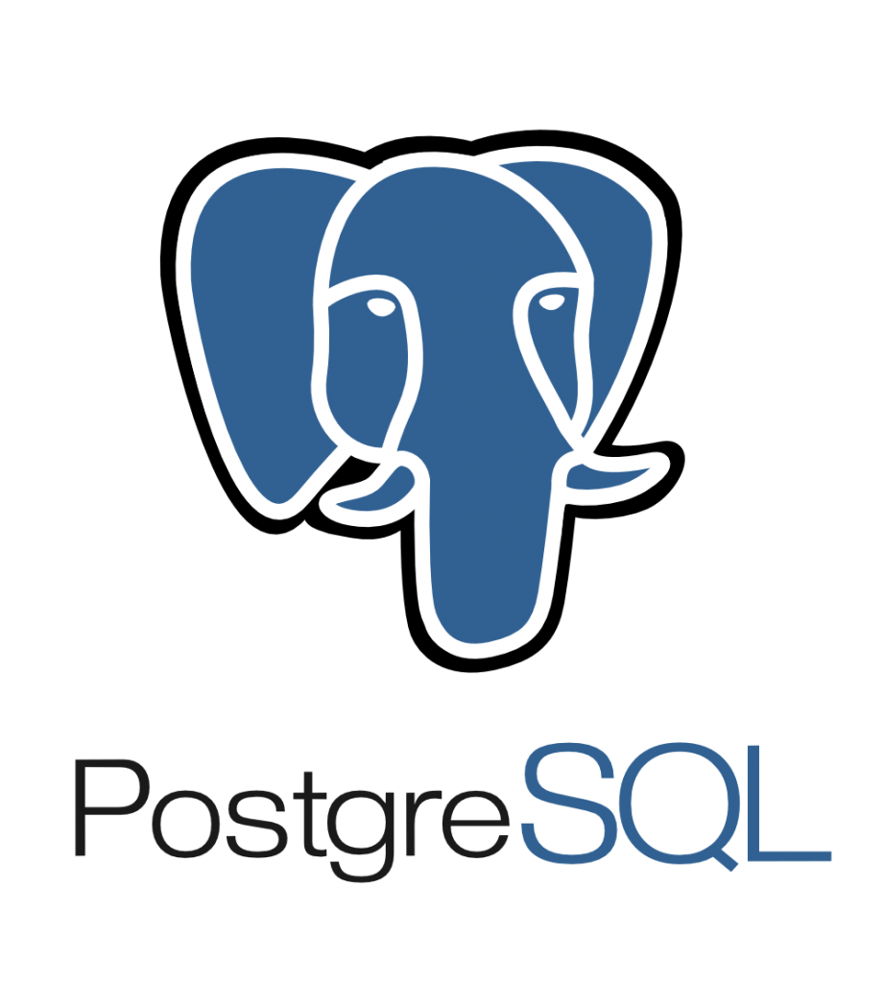

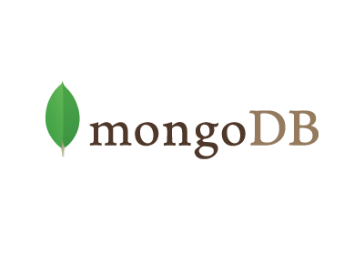
Modernize Java applications on Azure
Modernize
Modernize Java applications with comprehensive AI integration, advanced developer tools, and seamless cloud solutions for innovation
Java EE/Jakarta EE application servers
Fully managed offerings for any Java app – Spring Boot, Tomcat, and Java EE including JBoss EAP
Containerized Java applications on Azure Kubernetes Service with templates for Oracle WebLogic, IBM WebSphere
Native JAR and Spring support for code to cloud with serverless on Azure Container Apps and Functions
Java developer tooling with GitHub Copilot, Microsoft build of OpenJDK, Visual Studio code for Java and Azure plugins for Eclipse and IntelliJ
Unleash the power of AI in your Java applications – LangChain4J and Spring AI, Azure OpenAI Client Library for Java, Semantic Kernel for Java
End-to-end cloud experience supported by strategic partners - Red Hat, Oracle, IBM, Redis, Elastic and Confluent
Java application frameworks
Developer tools
Open-source databases

Slide 59


Enhance existing apps with AI powered experiences
Modernize
Identify use case and select suitable model
Embrace AI-enabled tools in every step of the development and deployment cycle
Modernize your apps to API-centered architecture for easier AI adoption
Leverage cloud-based data store and processing
Optimize your app for scalability and performance with serverless or container-based platform services

Slide 60


Customer story
“Microservice architecture with AKS enables us to seamlessly execute frequent releases for individual services. The platform is highly adaptable, making changes and scaling operations easy to automate. Its user-friendly interface facilitates easy automation of tasks. Overall, AKS has proven to be a reliable, agile, and scalable solution for our needs.”
Alex Zukerman, Chief Strategy Officer at Sapiens

Slide 61







Full support from Microsoft to ensure your success in Azure
App Patterns
Production
Customer Success
✅ Quick lightweight templates
✅ Devs new to Azure or Azure products
✅ Early PoC and trial
✅ Deploy reliable and modern applications
✅ Well architected/12 Factor app principles
✅ Dev-focused with code best practices
Fast Track Program
Developers
Engineering Engagements
Start Right App Templates
PoC
Azure Certifications
Enhance product and service offerings
AZ204 Dev
Landing Zone Accelerator
PoC → Production
✅ Production-grade well-architected workload infrastructure
✅ Design guidance on critical design areas
✅ Accelerate production journey using reference implementation
Contribution to OSS and communities
Azure Certifications
IT/ Cloud Ops
Azure Architecture Center
Well Architected Framework
Cloud Adoption Framework
AZ104 IT Ops
Infrastructure as Code enablement

Slide 62
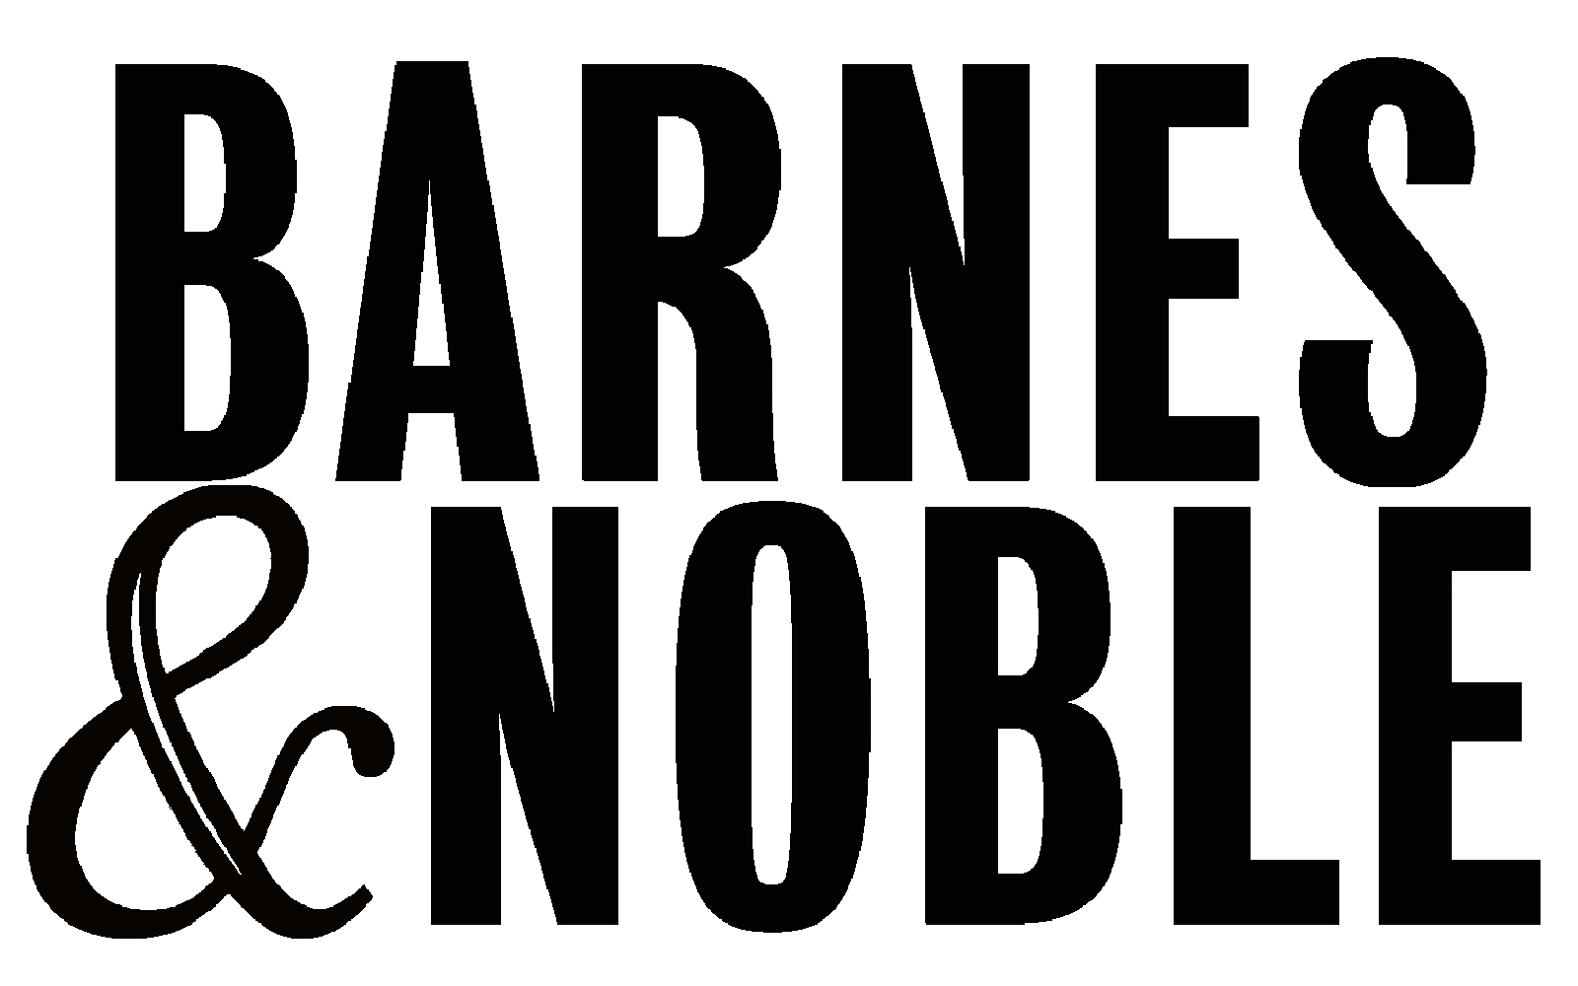














Azure Innovate Accelerate cloud and AI adoption with comprehensive resources, extensive coverage and expert help
Confidently adopt AI using a proven approach, expert help, and cost-effective offers
Offers and incentives to support your App, Data, & AI priorities
Application assessments & Proof of Value engagements
End to end coverage through comprehensive deployment offers
Expert help from specialized services partners and FastTrack for Azure
Learn more today! | aka.ms/AzureHeroOfferings

Slide 63
Delivering on intelligent apps transformation requires
Intelligent App use cases aligned to business outcomes
Modernization of existing application and data estate for AI
Platform operations for intelligent app deployment

Slide 64

Intelligent apps require a productive, secure, and reliable platform
Platform
Developer productivity
Operations at scale
Observability
Platform reliability
Platform security
Governance and cost optimization

Slide 65



Improve developer experience and productivity
Platform
Automated workflows
CI/CD for everything from idea to production with GitHub Actions
Automate app containerization, artifact creation, and deployments
Collaborate easily with Codespaces, Insights and the GitHub workflow
Templates and ”paved paths”
Prototype quickly with templates and solution accelerators
Faster, more consistent development with “everything-as-code” templates
Centralize templates in Azure Container Registry or GitHub
AI-assisted ops w/ Copilot in Azure
Copilot recommends the right services for your apps and environment
Quickly author complex commands and have Copilot act on your behalf
Troubleshoot across Azure services using natural language

Slide 66
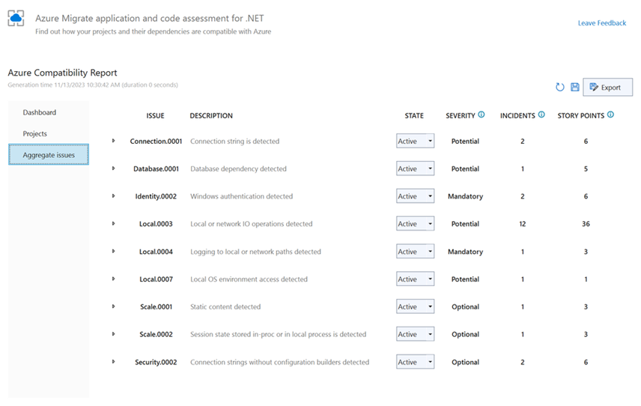
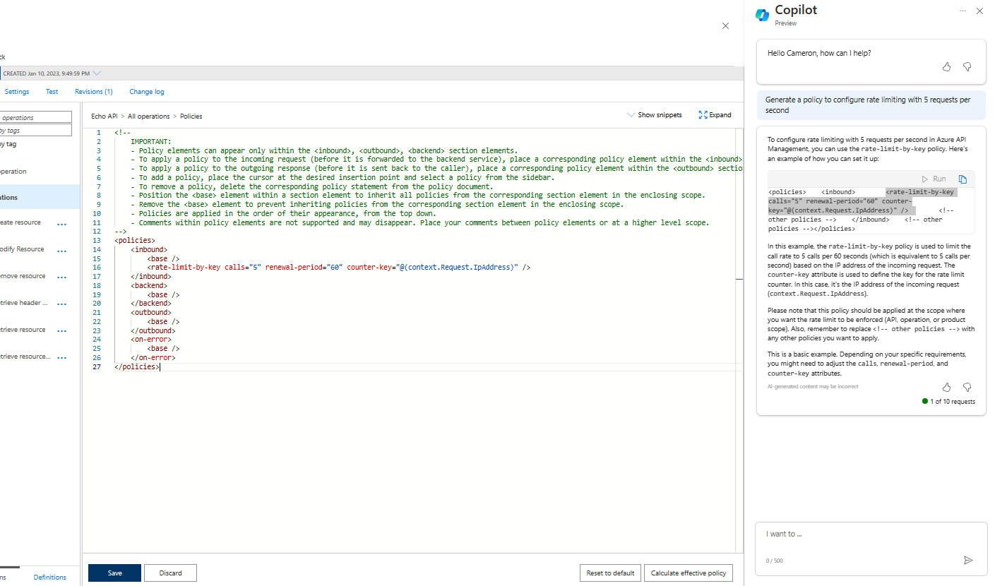
Microsoft Copilot in Azure
Platform
Generate deep insights instantly
Find personalized solutions for your workloads with an AI assistant that knows your environment.
Discover new cloud functionality
Ask Copilot questions using natural language to discover and utilize the full functionality of Azure services.
Do complex tasks faster
Optimize processes, resources, and workloads with AI orchestration and analysis.

Slide 67
Scale and performance for all your apps
Platform
Scale
Performance
60+ Azure regions, more than other cloud provider
Up to 99.95% application service availability SLA
Autoscale to meet any application demand
Up to 99.999% database availability SLA
5,000 node scale limit for AKS enabled by default
Up to 99.9% AI service availability SLA
Limitless and elastic scalability for your data
< 10 millisecond database latency

Slide 68
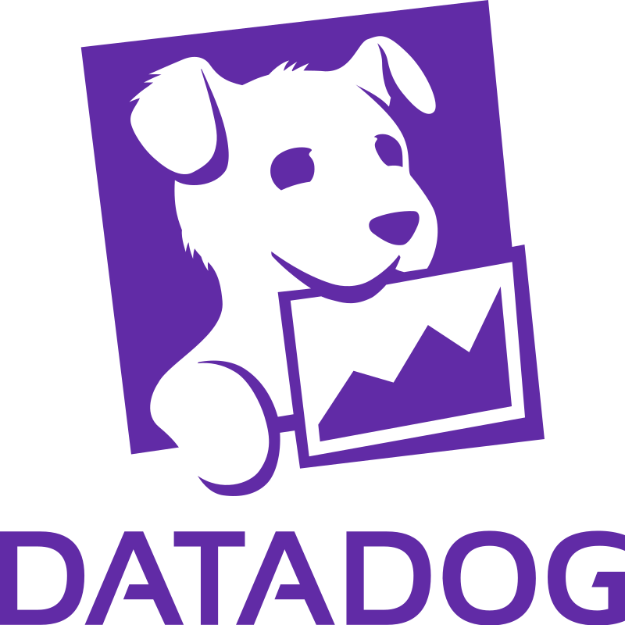



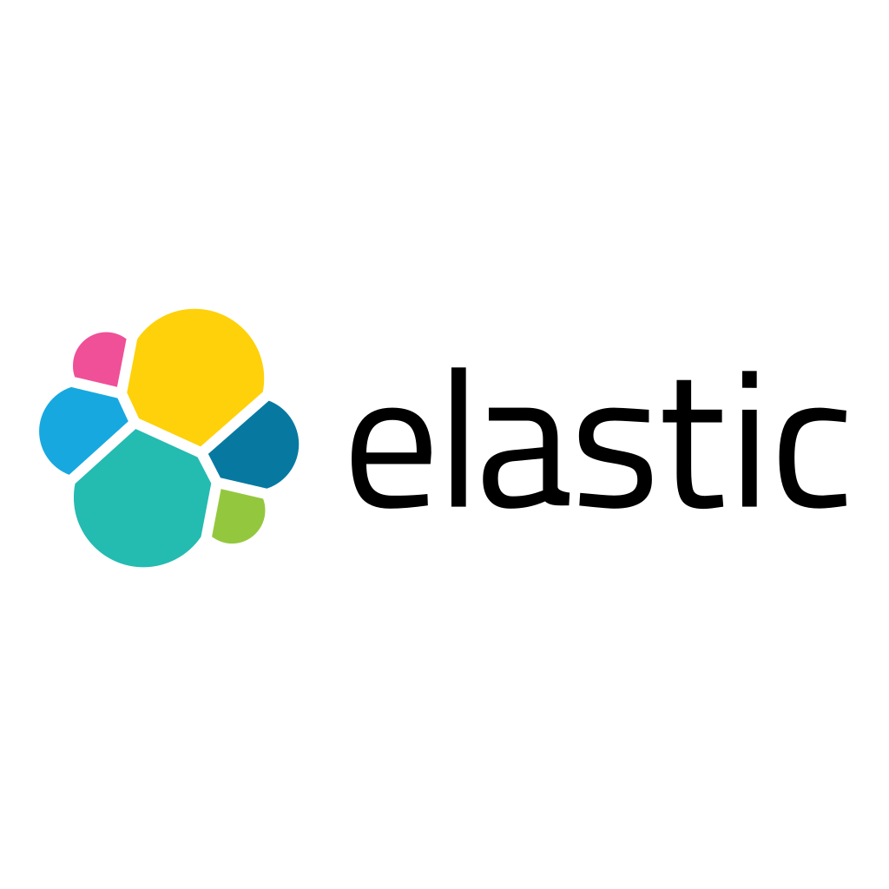




Monitoring and observability across your environment
Platform
Native platform capabilities
Leading APM tools
Azure Monitor
End-to-end observability for apps, infrastructure, and network. Azure Monitor managed service for Prometheus offers a Prometheus-compatible solution.
Application Insights
Application Performance Management (APM) for live web applications helps you enhance the performance, reliability, and quality of your applications.
Leverage your existing performance management and observability tools with easy Azure deployment
Log Analytics
Run log queries against data in the Azure Monitor Logs store, perform statistical analysis, and visualize the results in a chart to identify trends.
Azure Managed Grafana
Quickly and easily deploy Grafana dashboards with built-in high availability and control access with Azure security.

Slide 69






Built-in capabilities to ensure reliability and uptime
Platform
Design for reliability
Test for availability and resiliency
Availability Zones
Use Availability Zones and Zonal Redundancy to improve reliability for apps and databases.
Azure Load Testing
Generate high-scale load without the need for complex infrastructure and proactively identify performance bottlenecks.
Azure Backup
Configure backups for all your infrastructure, applications, databases, and storage workloads with ease from a central location.
Azure Chaos Studio
Improve application resilience by introducing faults and simulating chaos or outages.
Azure Kubernetes Fleet Manager
Reliably orchestrate upgrades and operations across multiple clusters.
Azure Playwright Testing
Run Playwright tests with browser and OS combinations hosted in the cloud for faster execution.

Slide 70
Secure your AI applications from code to cloud
Platform
Search for potential security vulnerabilities and coding errors
Scan and detect secrets checked into private repositories
Dependency review shows vulnerabilities before pull request merge
Detect malware and other threats across apps, databases, and storage
Understand risks in code, data, and identity to prioritize remediation
Prevent misconfigurations by scanning IaC templates and container images
Development lifecycle
Workload protection
GitHub Advanced Security
Defender for Cloud

Slide 71



GitHub Advanced Security - Security built into the developer lifecycle
Platform
Dependency insights
Vulnerability Management
CodeQL
Real-time inventory
License compliance
Vulnerability alerting
Automated code scanning
Private secret scanning
Largest vulnerability database
Automated security updates
World’s most advanced code analysis
Vulnerability hunting tool
Community of top security experts

Slide 72





















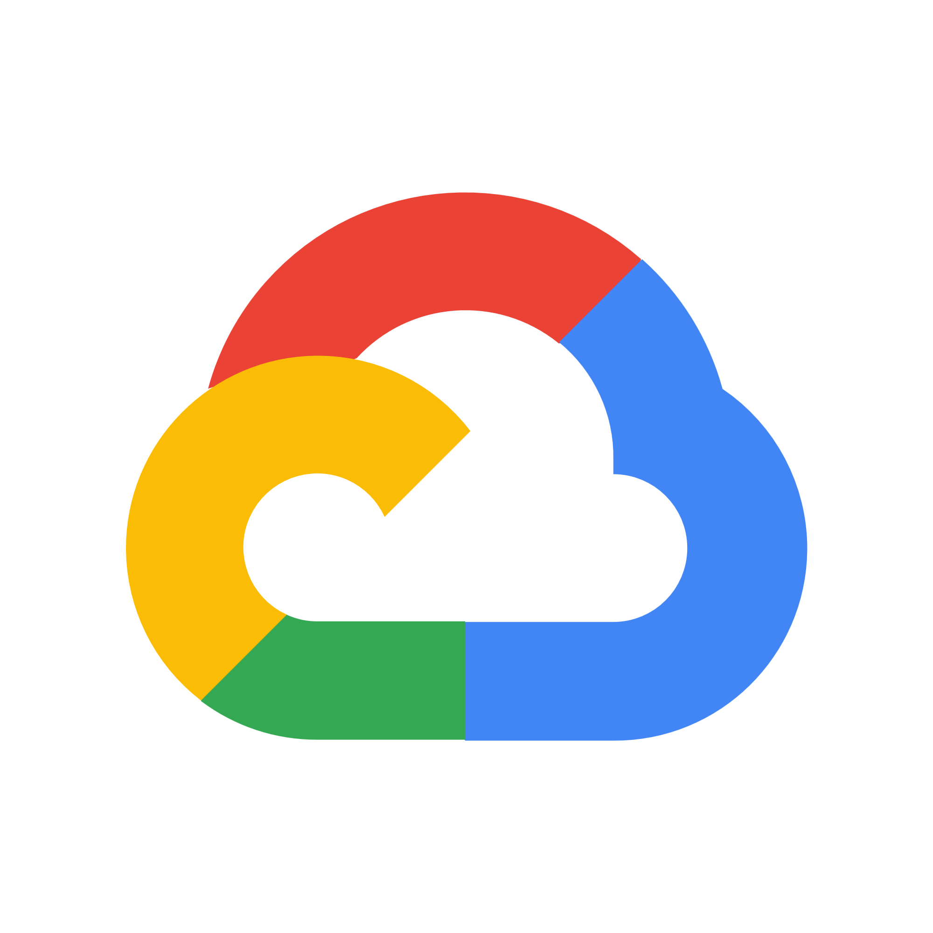



Multicloud workload protection
Platform
Compute:
-
Any server
Azure VMSS
Azure K8s
App Services
Unmanaged K8s
Service layer:
Microsoft Defender for Cloud
Azure DNS
Key Vault
Network Layer V1
Resource Management
Unify your DevOps security
Cloud Security
Posture Management
Cloud Workload Protection
Databases and storage:
Blob storage
File storage
Maria DB
Cosmos DB
Azure SQL
MySQL
Postgres SQL
SQL on VM
…
AWS workloads:
-
Amazon EKS
Amazon EC2
SQL on VM
Unmanaged Kubernetes
GCP workloads:
-
GKE clusters
Google Compute
SQL on VM
Unmanaged Kubernetes
On-premises
workloads:
Kubernetes
SQL on VM
Servers

Slide 73
Innovate confidently with a responsible AI platform
Platform
Azure AI Content Safety
Detect and assign severity scores to unsafe content
Works on human/AI generated content
Available as a Service (API) and integrated across Azure AI
Implementation Tooling
Responsible AI Toolbox
Suite of open-source tools designed to help you assess, develop, and deploy AI responsibly
Responsible AI Standard
Foundation & Principles
Product development requirements that Microsoft follows to implement responsible AI

Slide 74
Deploy foundation models with a built-in safety system using Azure AI
Platform
Customer Application
Prompt
Azure OpenAI Service Endpoint
Filtered Response
Completion
Filtered Response
Synchronous Content Filtering
Abuse Concern?
Azure AI Content Safety
Asynchronous Abuse Monitoring
Self-Harm
Violence
Sexual
Hate
Customers may apply to modify monitoring for Azure OpenAI Service endpoints: https://aka.ms/oai/modifiedaccess

Slide 75


Optimize resources, control costs, and apply best practices
Platform
Cost optimization
Governance
AI-powered functionality provides insights and spend forecasting
Implement cost management policies with budgets and cost allocation
Recommendations to reduce costs through identification of idle and underutilized resources
Comprehensive compliance view of all your resources and proactive recommendations
Real-time cloud compliance and automated remediation
Manage policies-as-code and surface policy compliance in workflows

Slide 76
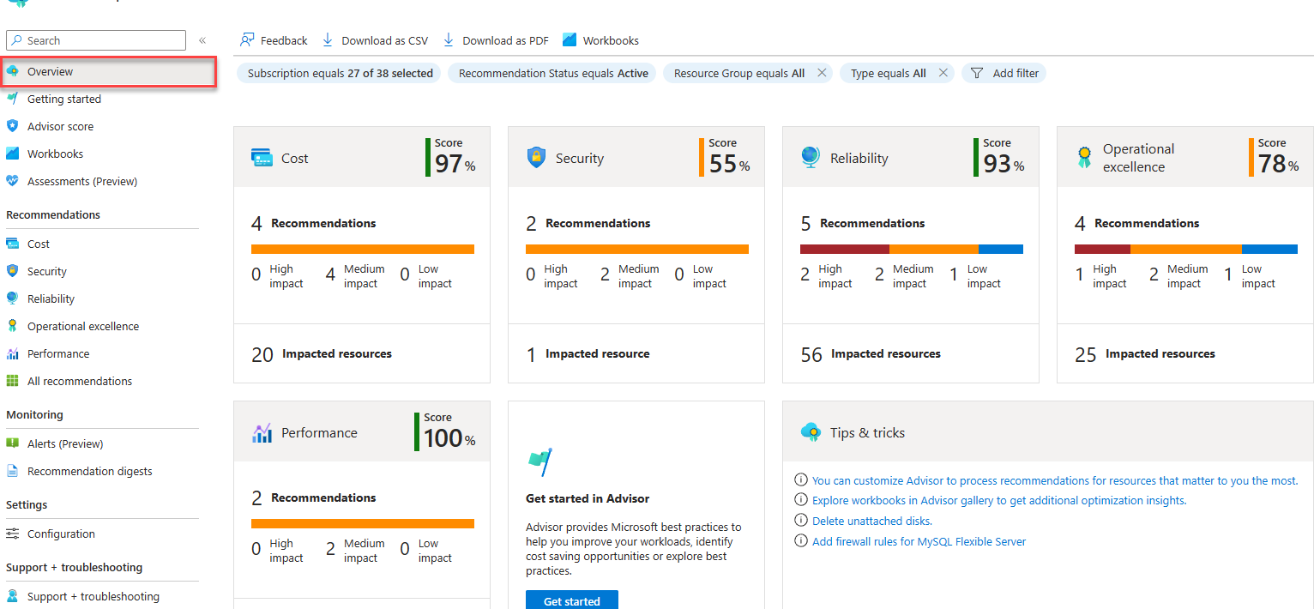
Azure Advisor
Platform
Personalized recommendations to improve reliability security, and performance, achieve operational excellence, and reduce costs

Slide 77
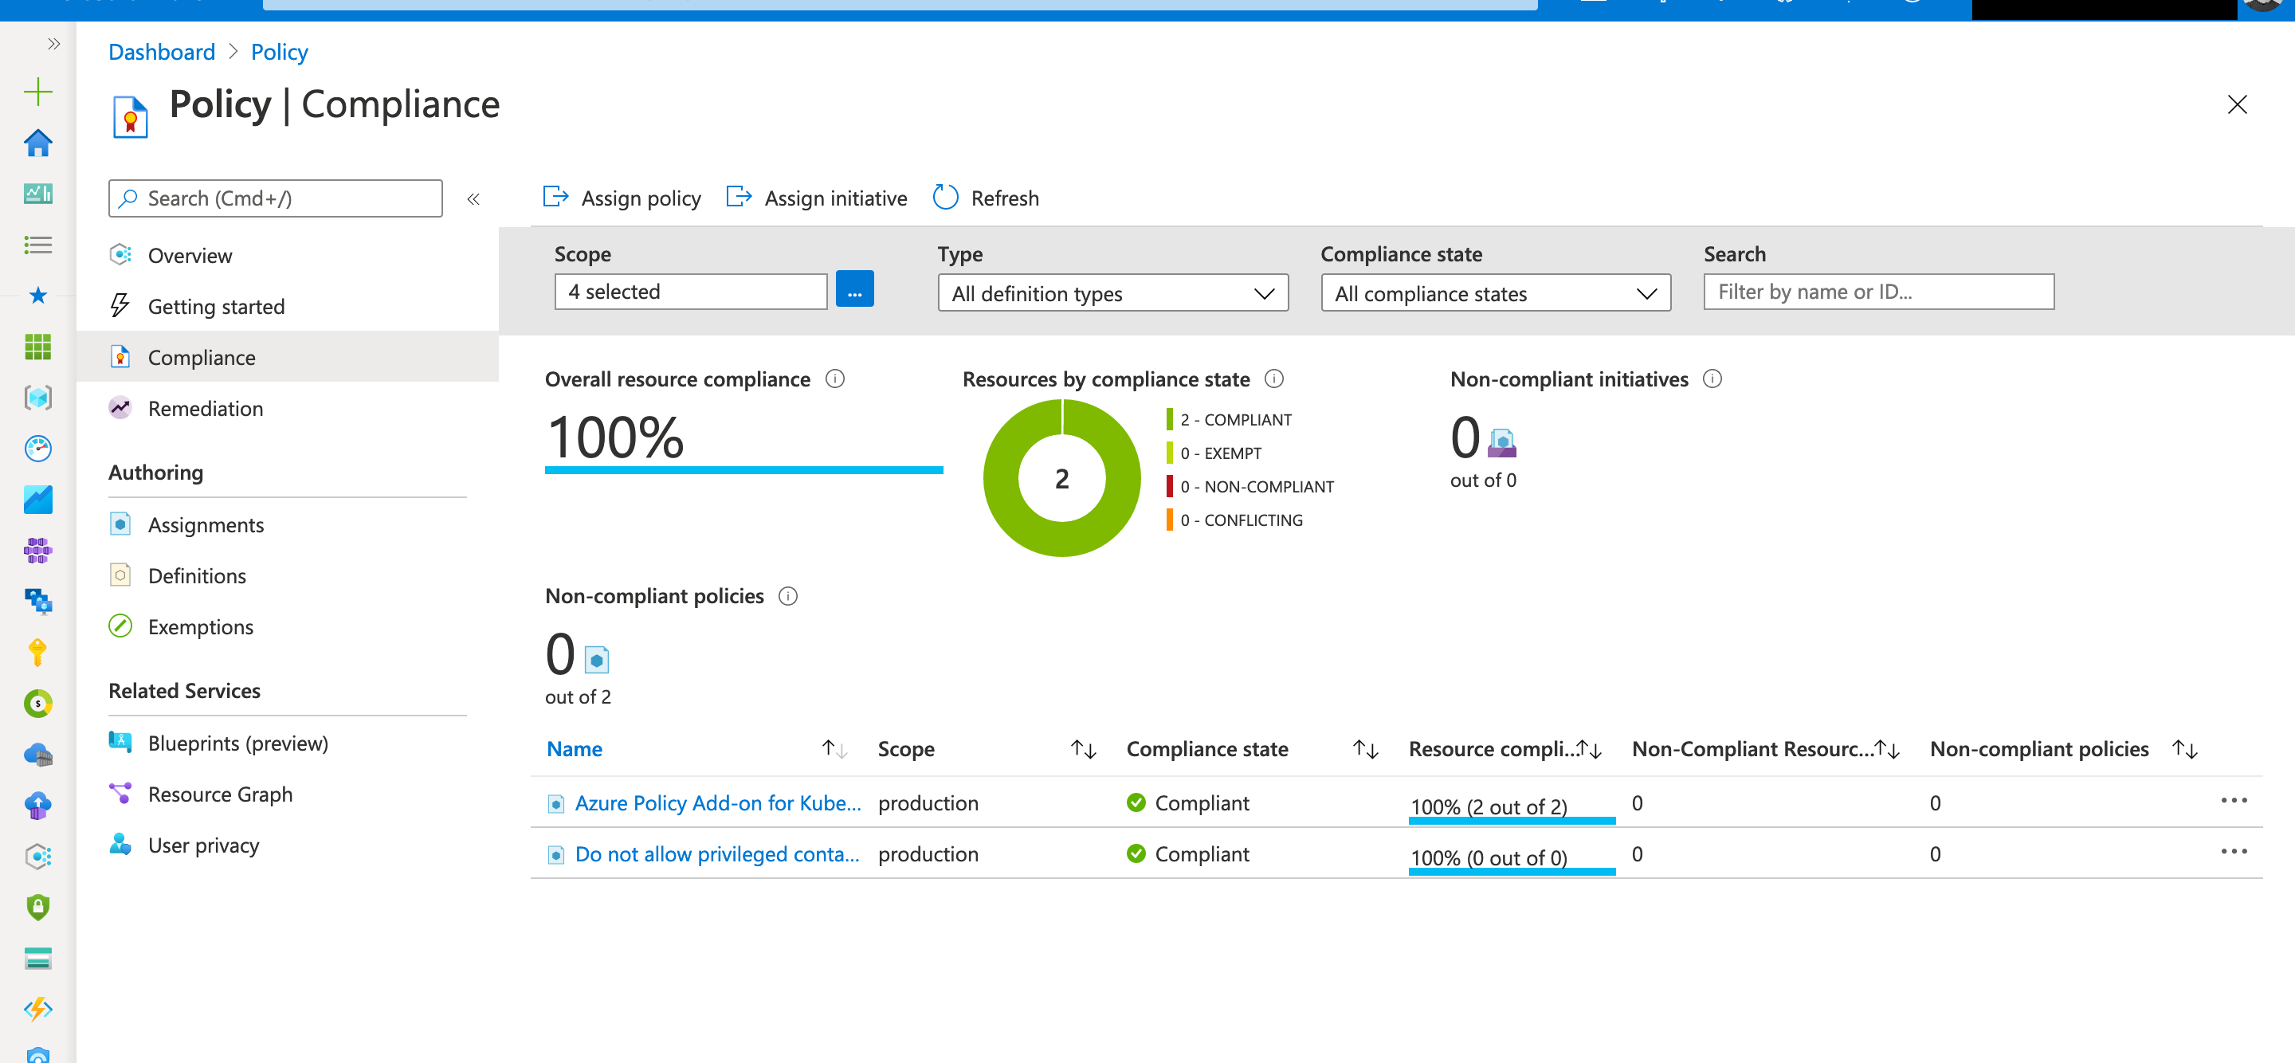
Azure Policy
Platform
Real-time cloud compliance at scale, including cost Automated remediation of existing resources
Native integration with GitHub and Azure DevOps to manage policies-as-code

Slide 78
Realize the power of AI apps for your business today

Slide 79
Follow the right steps to drive value for your business
Identify AI app use cases
Assess your app landscape
Leverage an integrated AI app platform
Optimize operations
Align your AI app uses cases business outcomes with technical patterns and case studies.
Assess your current application landscape and develop a strategy to build new or modernize.
Build and modernize with an integrated AI app platform, scalable data services, and pretrained and responsible AI.
Leverage operational best practices for enterprise-grade scale, performance and security.

Slide 80
Get started with Azure Innovate
Envisioning workshop
Connect your desired business outcomes with possible solutions
Proof of concept
Put your intelligent apps vision into action with a technical pilot with our free app assessment tools and technical app patterns and templates
Move to production
Leverage funding and partners/implementation resources to move from pilot to production

Slide 81
Take advantage of extensive Azure resources
Offerings
Offers
Partners
Guidance
Skilling
Azure Innovate
Build and modernize AI Apps
GitHub Copilot + AKS
Save on GitHub deployments to AKS
Azure Specialization
Certified Apps, Data, and AI partners
Reference architectures
Leverage enterprise-grade best practices and Designated Engineering offers
Transform with Microsoft AI
Apply AI to drive business outcomes
Microsoft Unified
Accelerate your success with expert-led support services
Azure AI Advantage
Get up to $6,000 of Azure Cosmos DB service for 90 days
Partner App Deployment
Funding for deployment through Azure partners
Optimization guidance
Maximize your cloud investment
Microsoft Learn
Self-paced training and docs

Slide 82
Appendix

Slide 83

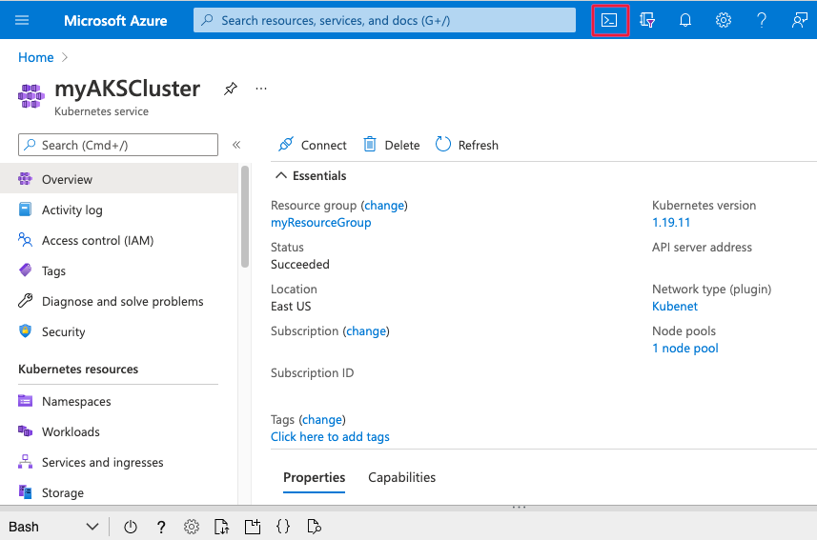



Azure Kubernetes Service (AKS)
Fully managed Kubernetes from cloud to edge
Fastest way to get Managed Kubernetes clusters
Seamless DevSecOps with CI/CD integration
Enterprise-grade security and policy controls
Forefront of cloud native innovation
Present in more regions than any other cloud provider
Consistent across cloud, heavy and light edge

Slide 84
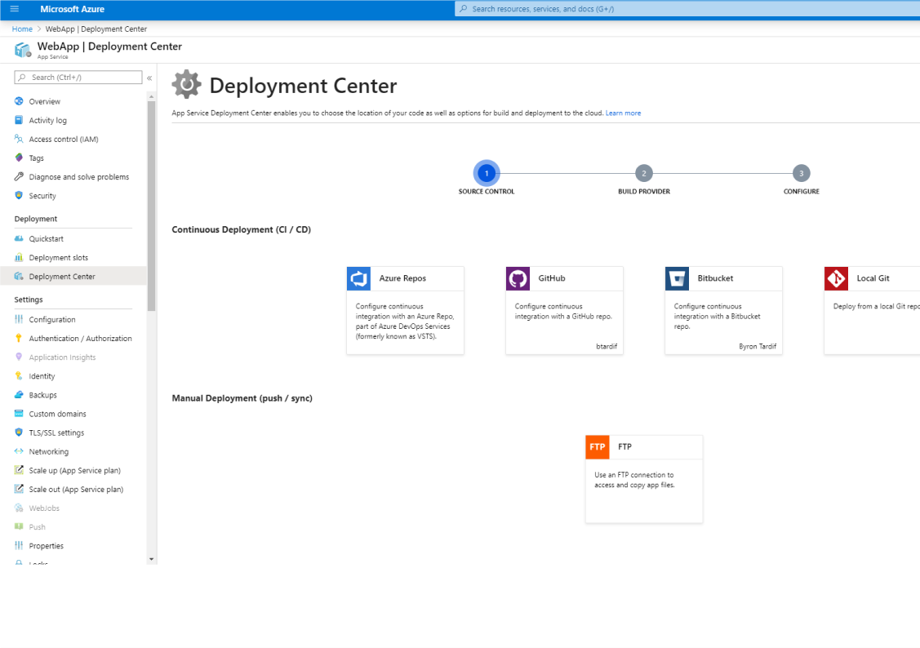
Azure App Service
Fully managed platform as a service (PaaS) to quickly scale AI apps and APIs globally
Deploy any web app, API, code, or container
Managed and secured runtimes for popular languages
Auto-scale and load balancing done by the platform
Deployment slots and staging features
Fine-grained control over application network traffic
Rich diagnostics using Microsoft Copilot for Azure

Slide 85

Azure API Management
Fully managed platform to publish, manage, secure, analyze APIs on a scalable platform
Full lifecycle management for APIs
Unified API management across hybrid and multi-cloud
Developer portal customizations
Out-of-box security (Authentication, Authorization, OWASP Top 10 API Security Threat Protection, more) and compliance (HIPAA, PCI, more)
GenAI Gateway capabilities provide enterprise-wide, federated access to manage and secure Azure OpenAI Services endpoints

Slide 86

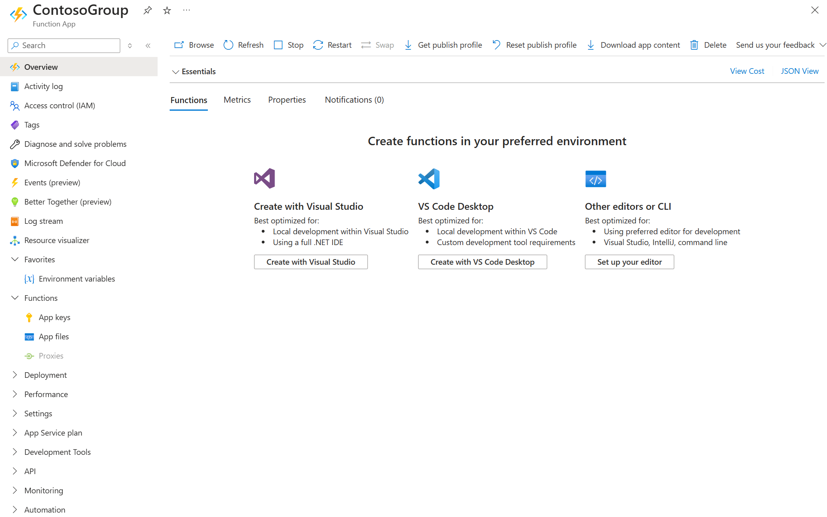
Azure Functions
Serverless, event-driven apps at extreme scale
Fast and high-performance auto scaling
Full local development with integrated CI/CD
Managed .NET, Node, Java, Python, PowerShell
Built-in integration for 20+ event sources
Flexible hosting options for diverse applications
Orchestration with Durable Functions

Slide 87

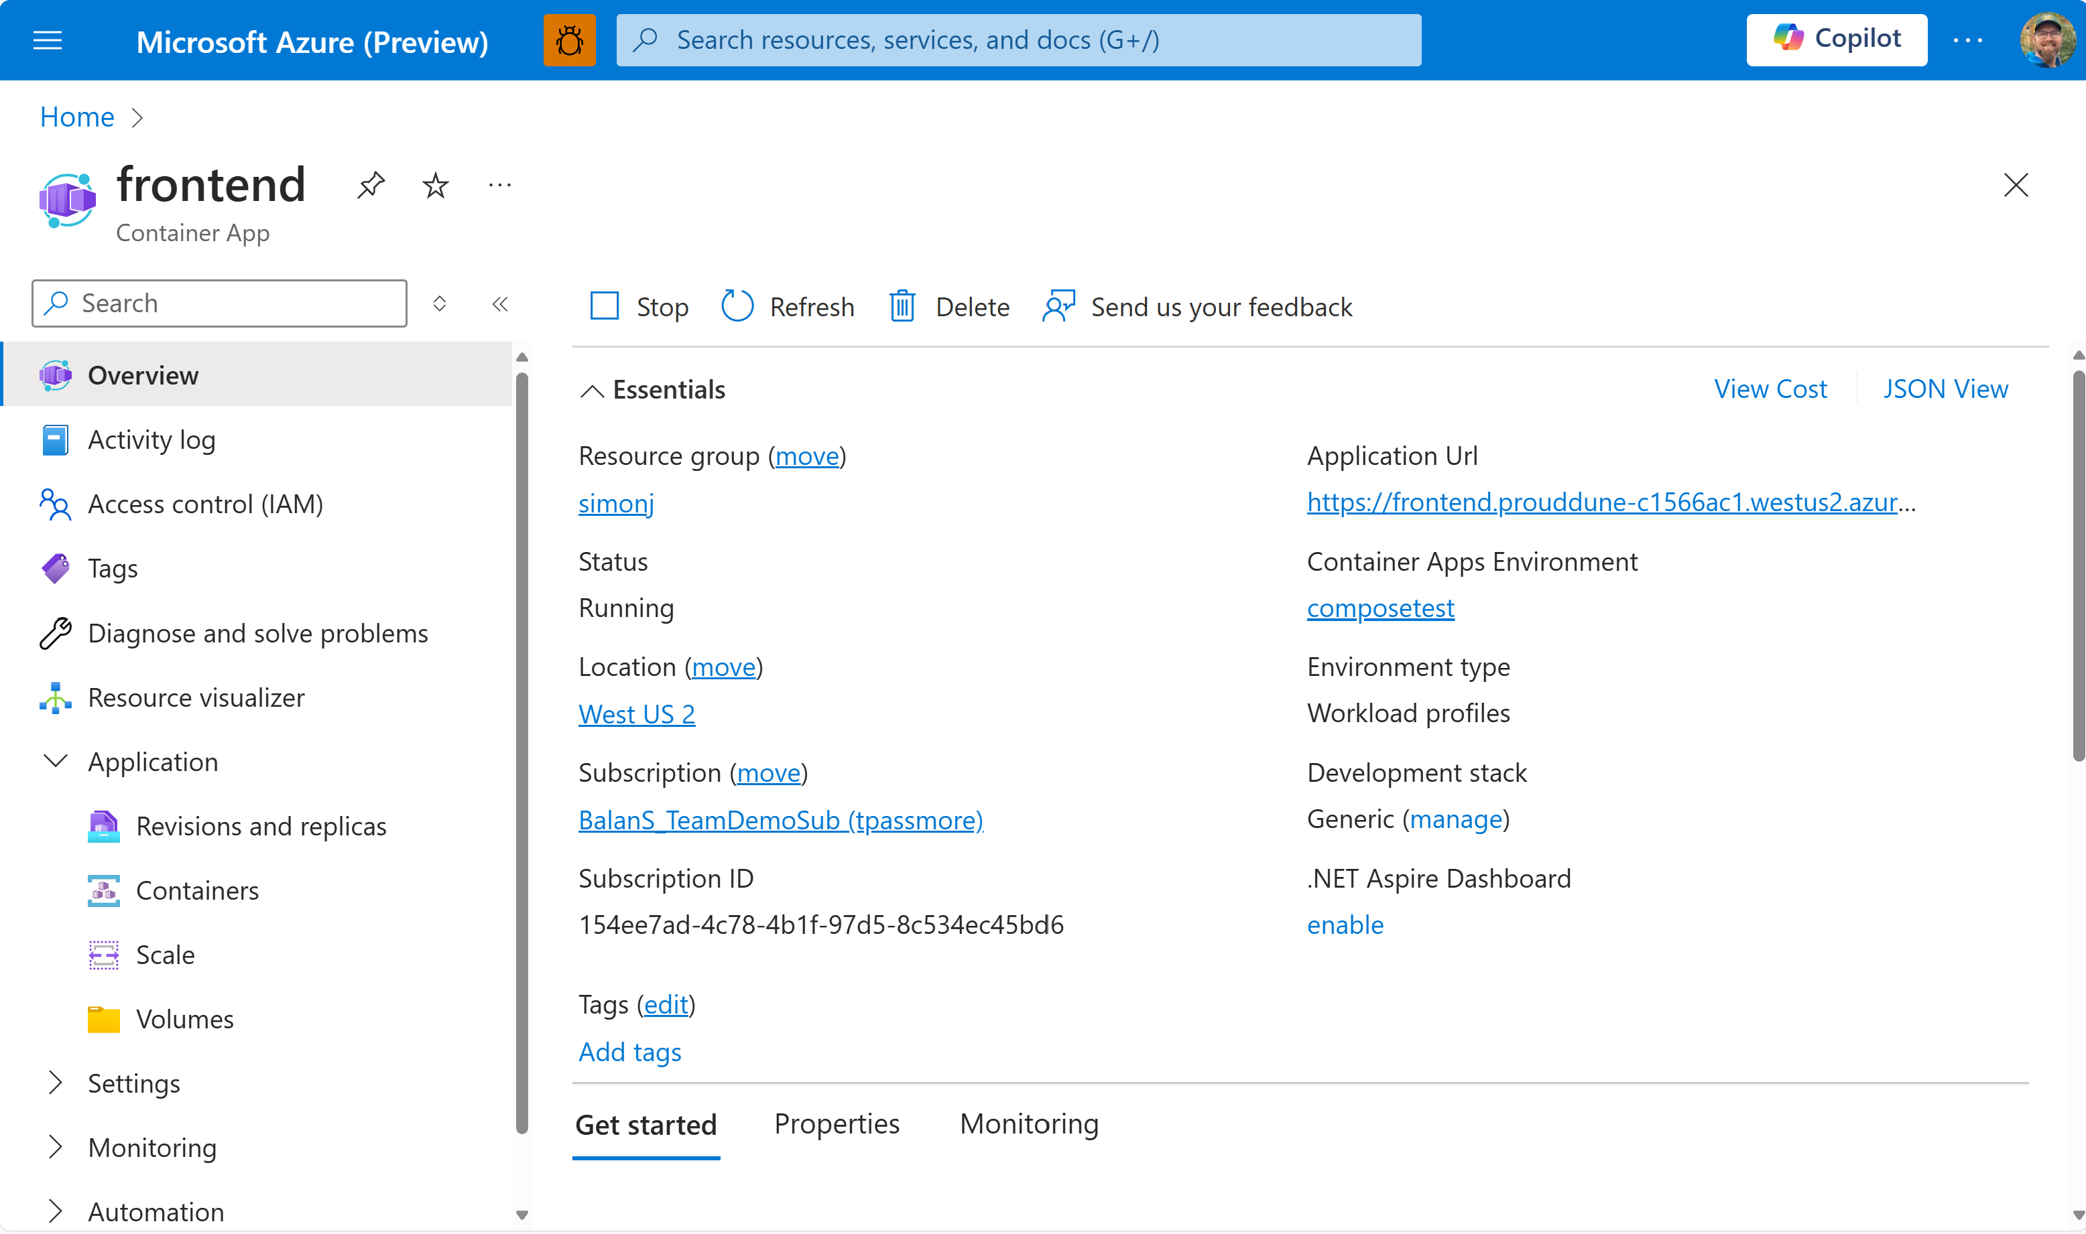
Azure Container Apps
Developer-first, serverless containers at any scale
Simple: Fully managed service with built in DevOps
Scalable: Seamlessly scale from zero to hyperscale
Efficient: Use our curated stacks to deliver more quickly
Secure: No root needed -- ever
Integrated: Built-in Dapr, KEDA, and Envoy

Slide 88

Azure Cosmos DB
Develop AI-powered apps at any scale
Secure and available
Highly Scalable
AI-ready
Real-time
Handle any data, in any amount
Built-in vector database
Power AI apps and models with real-time data at any scale
Enterprise-grade, multilayer security
Serverless or unlimited dynamic autoscale
Build and use copilots
<10ms latency SLA
SLA-backed 99.999% availability
Get started with free tier
Easy integration with OpenAI
Build with any language
Flexible options for continuous backups and point-in-time restore

Slide 89
Azure Database for PostgreSQL
AI-ready for mission critical enterprise applications
Enterprise Security
Mission-Critical Availability
Highly Scalable
Cloud Native AI App Ready
Microsoft Entra ID
High Availability
Up to 96 vCores
Native OpenAI Integration
Self-Managed Encryption
Geo-redundant Backup
Up to 64TB and 80K IOPS
Built-in Vector support
Private Link
Multi-Region Geo DR
<20 seconds to scale
Cost-Effective Development

Slide 90





Azure SQL Database Fast, flexible, secure modern app development for workloads big or small
Deliver AI-ready apps faster
Accelerate development and time-to-market with a seamless development and integration experience that eliminates the complexities of daily administrative tasks.
Optimize application performance
Optimize price and-performance with flexible compute options that include auto-scaling serverless and ML-based tuning.
Build applications that grow with you
Rapid scale up and read scale-out plus flexible, auto-scaling storage grows with you.
Keep your data secure and available
Secure your data from threats with layers of protection, built-in controls, intelligent threat detection.

Slide 91

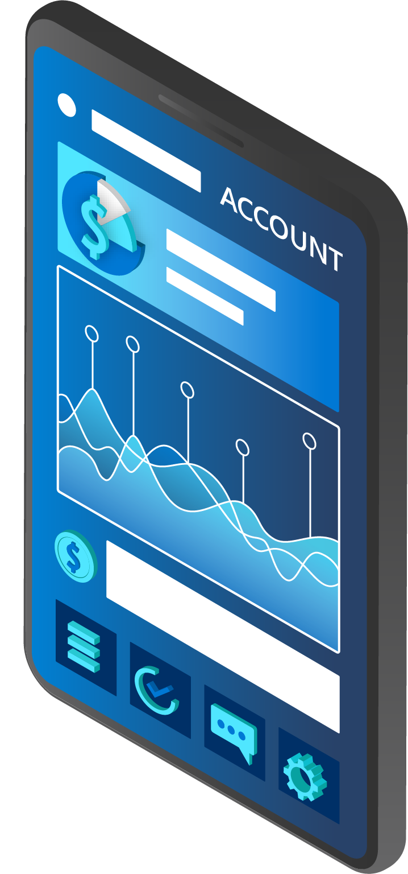
SQL Server on Azure Virtual Machines
SQL Server on Azure Virtual Machines saves money and simplifies management of security and high availability at no additional cost
Higher Performance, Lower TCO
Simple, familiar SQL Server
Robust and simple HA/DR
Built-in and free security and management
Pay up to 28% less than AWS*
Bring your existing skills, tools, and frameworks to the cloud seamlessly
Easily configure Always On and utilize free HA/DR license benefits
Automatic security updates and simplified storage configuration management
* Footnote: Performance and price-performance claims based on data from a study commissioned by Microsoft and conducted by GigaOm in January 2023

Slide 92
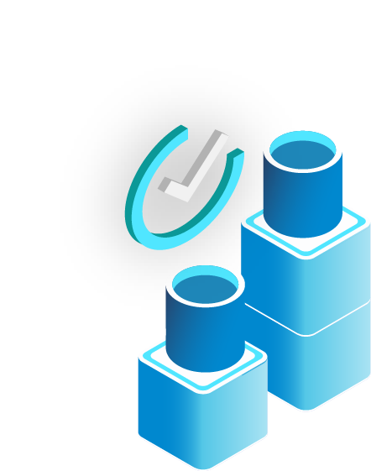


Azure SQL Managed Instance
Modernize SQL Server data at scale to a fully managed database as a service
Optimize performance for mission critical workloads
Increase DBA productivity
Keep your data secure and available
Enable hybrid flexibility for SQL data stored anywhere
Save with the best total cost of ownership
Modernize on the latest compute and storage technologies, optimized by ML-based tuning
Boost productivity on a fully managed and always up to date service that performs time-consuming tasks on your behalf.
Get industry-leading, multi-layered protection with built-in high availability.
Bring cloud connectivity and Azure innovation on-premises and migrate to Azure when you’re ready, on your terms.
Meet mission critical requirements while costing up to 93% less than the competition1
Advanced Data Security
Built-in AI
Always On Reliability
Optimizes performance and durability for you
Secure your data with layers of protection, built-in controls and leading compliance
Maximize uptime with built-in high availability and an industry-leading availability SLA up to 99.99%

Slide 93
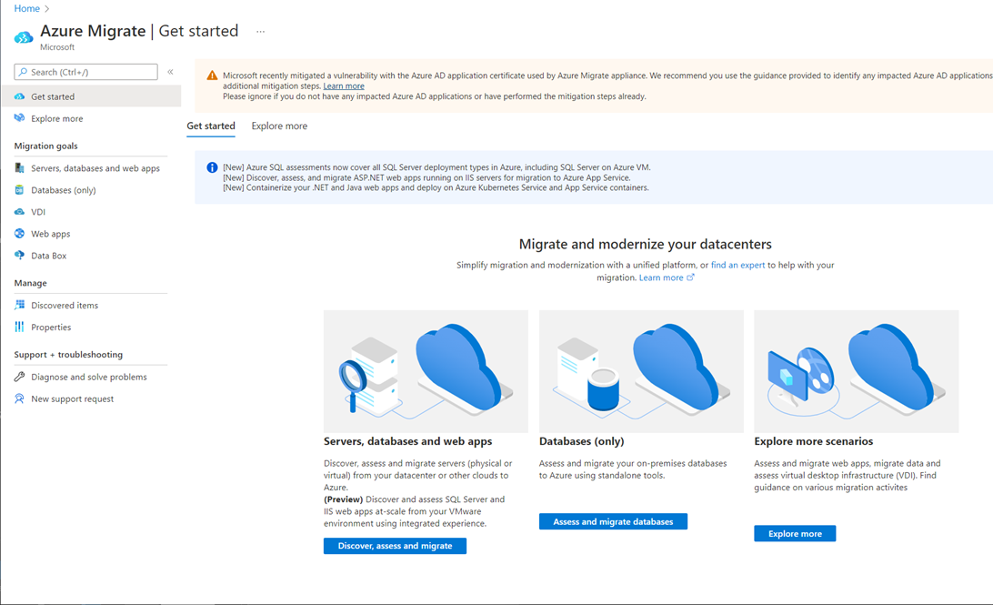
Azure Migrate A unified solution for migrating to and modernizing in Azure
Diverse capabilities
Comprehensive discovery, assessments and migration capabilities.
Multiple scenarios
Migrate Windows and Linux servers, databases, web applications and virtual desktops.
End-to-end visibility
Centralized repository for consistent end-to-end tracking and insights.

Slide 94
Azure Migrate Application and Code Assessment Cloud readiness assessment for Java and .NET Apps
Comprehensive apps and code assessment
Catch breaking code issues, dependencies and linkage before migration. Customize rulesets for specific use cases.
Supports binaries and source code
Produces comprehensive reports.
Intelligent remediation guidance
Provides an intelligent experience to assess source code and remediate issues with co-pilot integration.
Azure Migrate application and code assessment

Slide 95


Customer story
Modernize
“With Microsoft, we’ve achieved faster time to market with new customer propositions, empowered our developer teams to do more, reduced time for provisioning to new locations, and become more cost efficient.”
Jens Barnow, Senior Vice President, Group Technology, Nexi Group

Slide 96


Customer story
Modernize
“We are able to manage the system with greater capabilities; the system can heal itself, reprovision, and we can deploy to all of the stores at once. With Azure AI and our ongoing relationship with Microsoft, we’re excited about the possibilities for extending innovation even further across that omnichannel retail experience.”
Jon Hathaway, Senior Technical Lead DICK’S Sporting Goods

Slide 97


Customer story
Modernize
“Instead of doing six-week releases, we now do weekly releases. And the build times now take roughly 10 to 15 minutes, compared to what used to be a couple of hours.”
Anton Vishnyakov, Senior Engineer and Manager for Platform Engineering, Coles

Slide 98


Customer story
Modernize
“It was a natural evolution for us, moving from on-premises hosted .NET applications over to the Microsoft Azure cloud environment...to be able to migrate our applications seamlessly over to the cloud was a hassle-free exercise for us,”
Sahil Gupta, SVP Head of Application Development, NBA

Slide 99


Coca-Cola, Retail and Consumer goods
PERSONAS
Marketing
Industries:
Retail and Consumer Goods
Use cases:
AI-enabled marketing content generation
Situation:
Solution:
Impact:
Coca-Cola wanted to leverage the massive potential of OpenAI’s generative AI technology to enhance its marketing and consumer experiences—and also explore ways to improve business operations and capabilities.
Coca-Cola is using GPT-4 to power its internal productivity chatbot for a ChatGPT-like experience. Additionally, Coca-Cola is using GPT-4 models for its knowledge hub, which leverages Azure Cognitive Services along with Azure OpenAI to answer questions on their data.
Coca-Cola is looking to build a Marketing POC that will integrate digital marketing with Open AI, enhancing the content generation experience. Leveraging the capabilities of GPT-4 for innovative marketing solutions has also opened exciting possibilities for Coca-Cola in organizational and business growth.​
Read the press release

